Slide 1
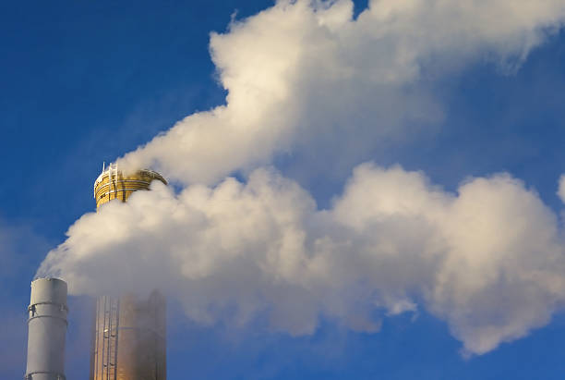
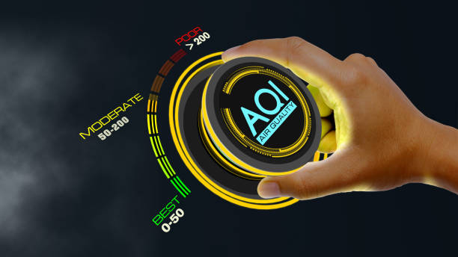
air quality analysis in tamilnadu
Phase 1 Project

Slide 2

group 9
Group members :
Aarthi.A
Abi.M
Kavialakshmi.T.R
Roshini.M
Sasikala.G
Guided by Mrs.B.Moohambikai

Slide 3
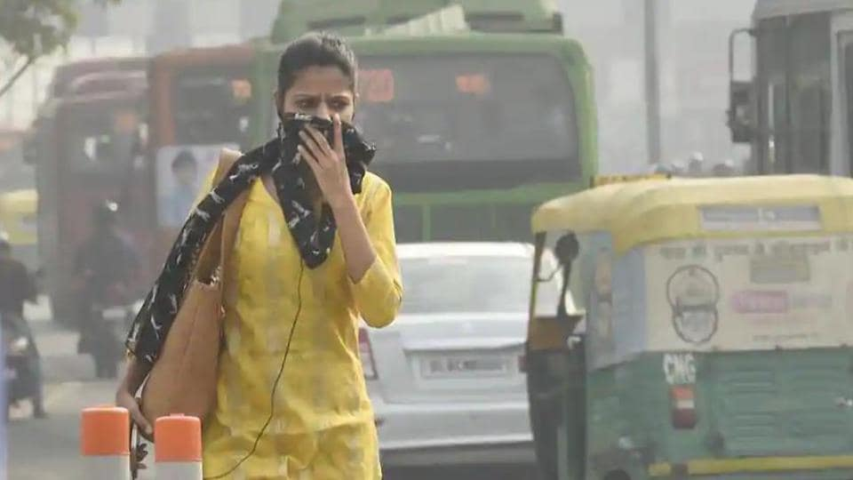
AGENDA
Introduction​
Objectives
​Table
Causes
Methodology
Problem Statement
Code
​Summary​

Slide 4
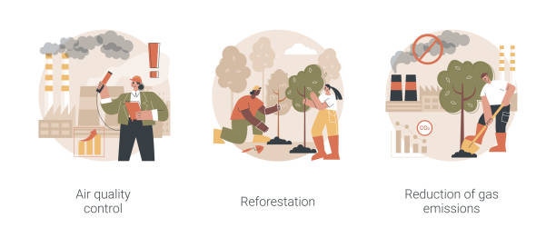
introduction
Air is an invisible substance surrounding the Earth and providing us all with the breathable oxygen and performs a vital role in supporting life on Earth.
Air pollution is the presence of one or more substance at a concentration above their natural levels, with the potential to produce an adverse effect.
In recent years, rapid industrialisation and urbanisation posed detrimental effect on environment.
It directly affects a population of millions who are suffering from shortness of breath, eye irritation to chronic respiratory disorders, pneumonia, acute asthma etc

Slide 5
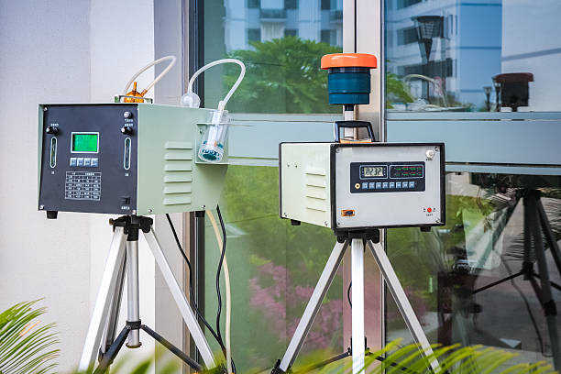
objectives
Air quality objectives are used to guide decisions unless they are written specifically into a permit or regulation at which point they become binding requirements.
They are typically used to:
=> Assess current or historical air quality.
=> Guide decisions on the permitting of new or modified facilities.
=> Aid in regulatory development.

Slide 6
Vehicle count at sampling location
SAMPLING LOCATION | TWO WHEELER | THREE WHEELER | LMV | HMV
Tiruchengode Bus Stand | 14375 | 1858 | 4257 | 1963
K.S.R College Campus | 1152 | 8 | 120 | 320
Pallipalayam Bus Stand | 12458 | 1215 | 3952 | 1622
Erode GH | 14375 | 1858 | 4257 | 1963

Slide 7
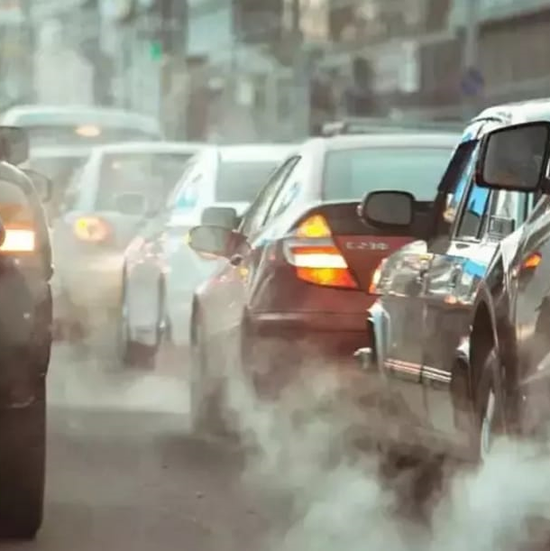
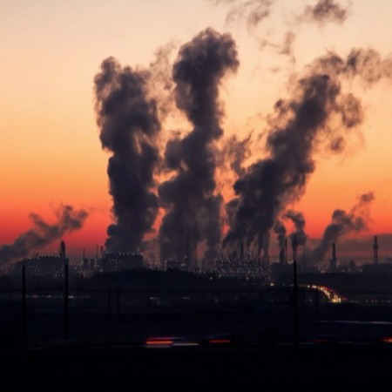
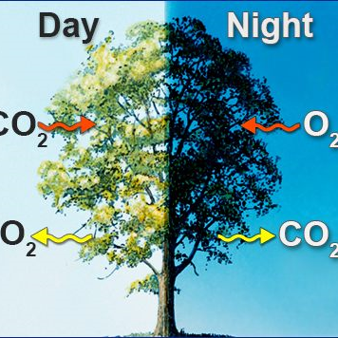
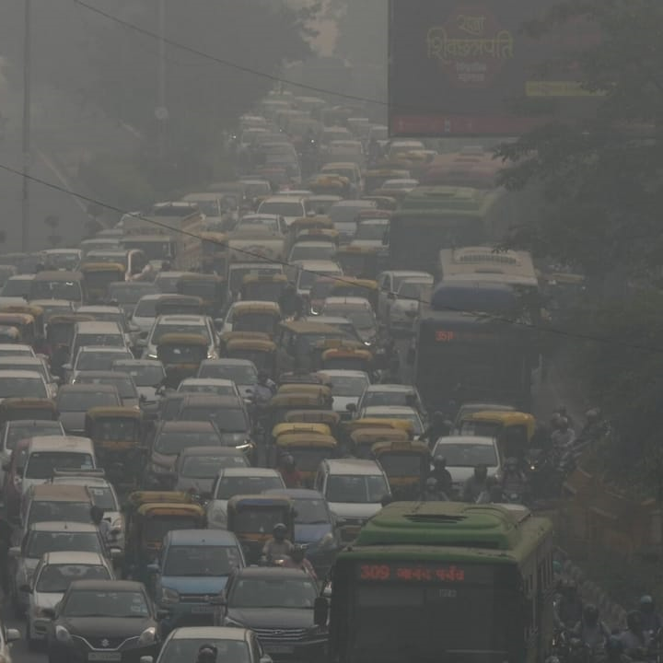
CAUSES OF AIR POLLUTIONS
Traffic due to cars
Releasing harmful air
Cutting trees ​
Carbon monoxide gas​

Slide 8

methodology
The sampling was carried out for 24 hours and the samples were collected for analyzing the particulate matter concentration.
Baseline Sampling
The various Baseline parameters considered of importance in the ambient air sampling project are point sources contributing to emission of particulates. point source include hotel and bakeries and non point source include vehicle. A brief survey was conducted around location and hourly inflow of vehicles was analyzed by direct observation.
PM10 Sampling
The particulates in the ambient air are collected by using Reparable Dust Sampler (RDS). Air is drawn through the sampler filter at a controlled flow rate by a pump located downstream of the sample filter. The instrument operated for 23 hours per day. The mass concentration can becalculated measuring the weight of collected matter in known volume of air sampled.

Slide 9
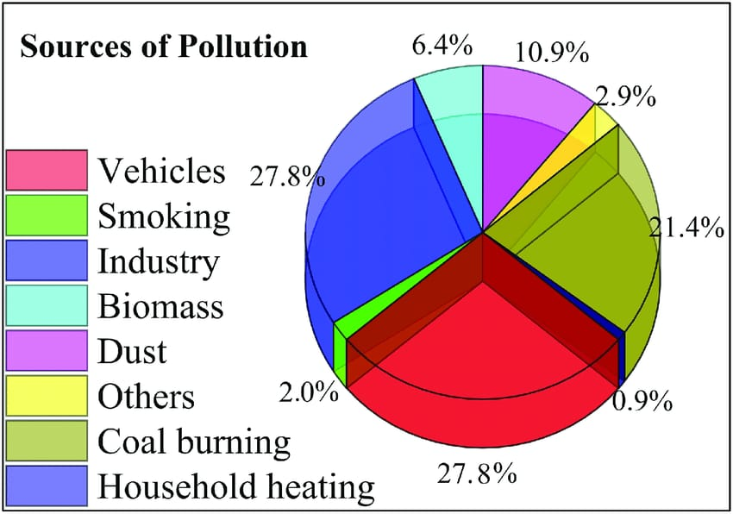
PM2.5 Sampling
The fine particles in the ambient air collected using ambient fine dust sampler. Air is drawn through the sampler filter at a constant flow rate by a pump located downstream of the sample filter. The flow of air through the sampler must be at a flow rate to ensure that the site cut-off at 2.5 microns occurs. The instruments are operated for 23 hours per day.
Gaseous Sampling
The gas inlet should be kept on the pipe after the cast minimum aluminum hopper but before the blower. There can be three inlets for different gases or one inlet through a manifold. Acalibrated rotameter (0 to 3 lpm) shall be provided for checking the flow rate. The instrument calibration curve is given in the annexure

Slide 10

PROBLEM STATEMENT
The problem statement for an air quality analysis in Tamil Nadu could be: “To assess and improve air quality in various regions of Tamil Nadu, this project aims to collect, analyze, and interpret data on key air pollutants such as PM2.5, PM10, NO2, SO2, CO, and O3. The objective is to identify sources of pollution, understand seasonal variations, and develop effective strategies for air quality management, ultimately working towards healthier and sustainable living conditions for the people of Tamil Nadu”.
This problem statement sets the stage for a comprehensive air quality analysis project, addressing the need to monitor pollutants, identify contributing factors, and propose solutions to enhance air quality in the region.

Slide 11
To address air quality issues in Tamil Nadu, a comprehensive solution statement could include:
1. *Air Quality Monitoring*: Implement a robust air quality monitoring network across major cities and industrial areas in Tamil Nadu. This should include real-time monitoring of pollutants like PM2.5, PM10, NO2, SO2, and ozone.
2. *Data Analysis and Reporting*: Analyze the collected data and create a user-friendly platform or app where residents can access real-time air quality information. Regular reports should be published to raise awareness.
3. *Source Identification*: Identify major sources of air pollution, such as industries, vehicular emissions, and construction activities, through source apportionment studies.
4. *Emission Control*: Enforce stricter emission standards for industries and vehicles. Promote the adoption of cleaner technologies, such as electric vehicles and renewable energy sources.
5. *Public Awareness Campaigns*: Launch public awareness campaigns on the health impacts of poor air quality and educate residents on measures to protect themselves, like using masks and avoiding outdoor activities during high pollution days.
6. *Green Infrastructure*: Invest in green infrastructure, including urban parks and tree planting initiatives, to absorb pollutants and improve overall air quality.
7. *Traffic Management*: Improve public transportation systems, encourage carpooling, and implement traffic management strategies to reduce congestion and vehicle emissions.
8. *Regulatory Enforcement*: Strengthen regulatory bodies and their enforcement capabilities to ensure industries comply with emission standards and environmental regulations.

Slide 12
9. *Research and Innovation*: Support research and innovation in air quality management, including the development of new pollution control technologies and sustainable urban planning practices.
10. *Cross-State Collaboration*: Collaborate with neighboring states and central government agencies to address regional air quality issues, as pollution often transcends state boundaries.
11. *Policy Advocacy*: Advocate for policies that promote clean energy, sustainable transportation, and environmental conservation at the state and national levels.
12. *Emergency Response Plan*: Develop an emergency response plan to tackle severe pollution events, including advisories for vulnerable populations.
13. *Community Engagement*: Involve local communities and NGOs in air quality improvement efforts through citizen science programs and community-driven initiatives.
14. *Long-Term Goals*: Set clear long-term goals for air quality improvement, with regular assessments and adjustments to policies and strategies.
15. *Funding Allocation*: Allocate sufficient funding and resources to implement these measures effectively.
This comprehensive approach combines monitoring, regulation, public engagement, and sustainable development to address air quality issues in Tamil Nadu and improve the overall quality of life for its residents.

Slide 13
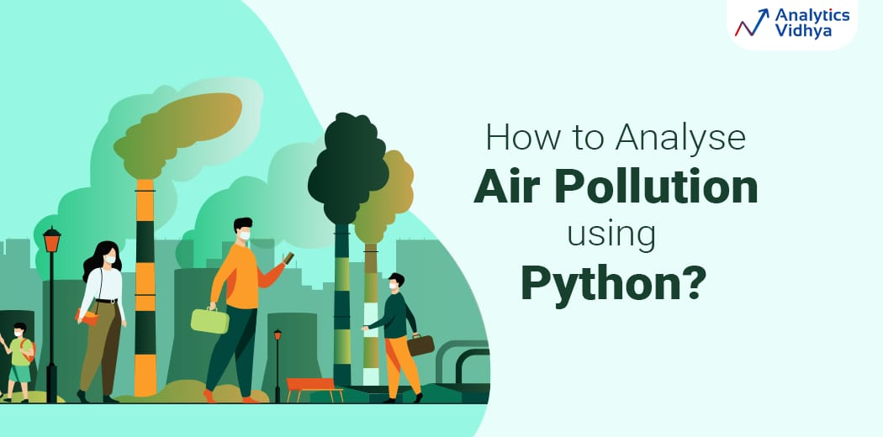
PYTHON CODE
import requests
import
matplotlib.pyplot as plt
# Fetch air quality data for Chennai from OpenAQ API
url = https://api.openaq.org/v1/measurements
params = { "country": "IN", "city": "Chennai", "parameter": "pm25", # PM2.5 particulate matter}
response = requests.get(url, params=params)
data = response.json()
# Extract dates and PM2.5 values
dates = [entry['date']['utc'] for entry in data['results’]]

Slide 14

pm25_values = [entry['value'] for entry in data['results’]]
# Create a time series plot
plt.figure(figsize=(12, 6))
plt.plot(dates, pm25_values, marker='o', linestyle='-’)
plt.xlabel('Date and Time (UTC)’)
plt.ylabel('PM2.5 Value (µg/m³)’)
plt.title('Air Quality in Chennai’)
plt.xticks(rotation=45)
plt.grid(True)
plt.tight_layout()
plt.show()

Slide 15

SUMMARY
A comprehensive survey of air quality was carried out in Tiruchengode Bus Stand, K.S.R College Campus, Pallipalayam Bus Stop and Erode GH to assess the prevailing the air quality. The ambient air quality was analyzed with the ambient air quality standards of NAAQS. Ambient air sampling was carried out in Tiruchengode Bus Stand, K.S.R College Campus, Pallipalayam Bus Stop and Erode GH and the mass concentrations of PM10, PM2.5, SO2, NOX and CO were estimated. It was found that PM10 concentration exceeds the threshold limits. The higher vehicular density is one of the main reasons for the higher concentrations of these gaseous pollutants. Air Quality Index was calculated for the gaseous pollutants and for Particulate Matters. The results show that the selected locations come under moderate air pollution

Slide 16


